Slide 1

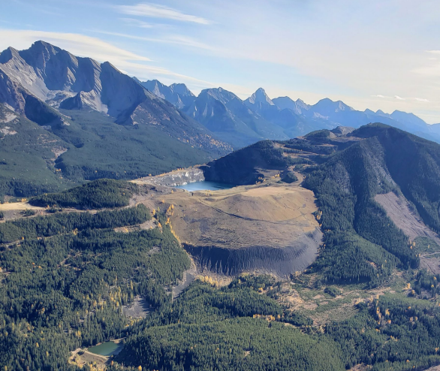

Lunch & Learn University of Calgary Schulich School of Engineering
HydroVault & Growth at TransAlta
April 17, 2024

Slide 2
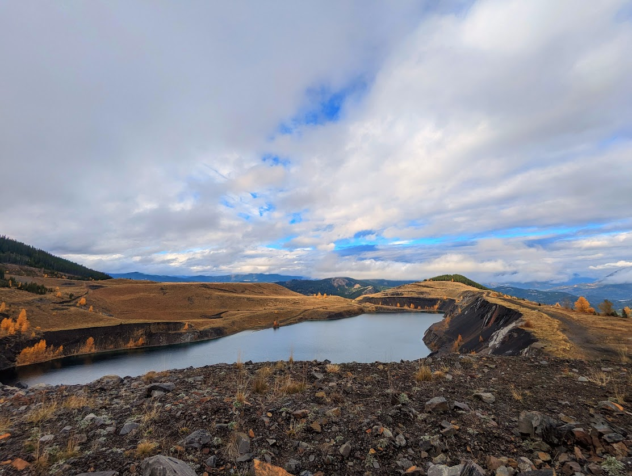
Agenda
Project Background
Proposed Reservoir Designs
Data Sources
Water Balance + Evaporation and Seepage
Hydrological Modelling & Analysis
Climate Scenarios & Future Storage
Operations Plan

Slide 3
Project Background

Slide 4
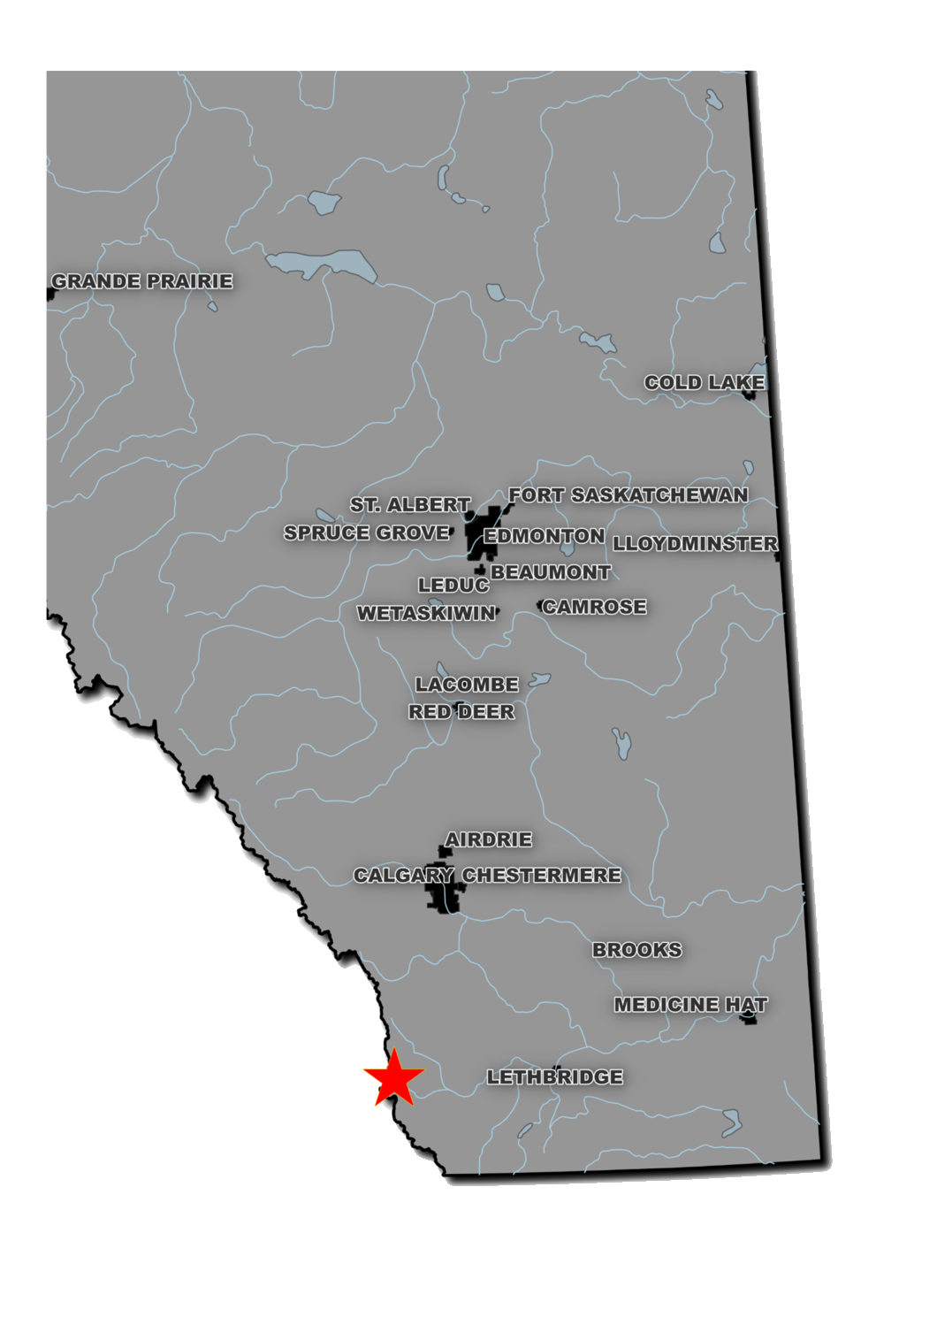

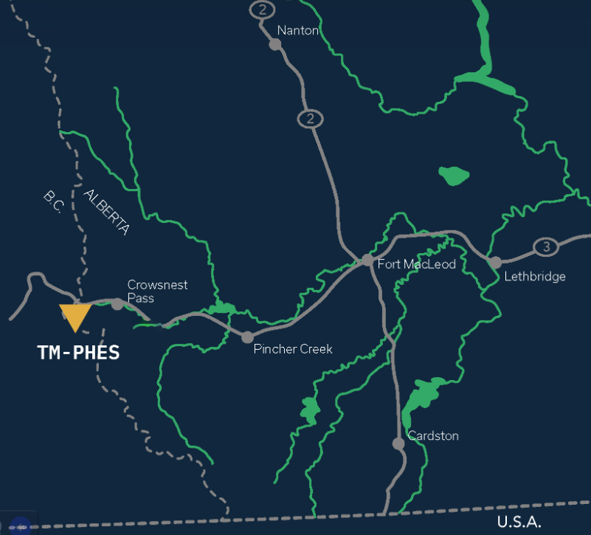
Background – Site Location
`
(Evolve Power, Tent Mountain Pumped Hydro Energy Storage 2023 https://evolvepower.ca/portfolio/tent-mountain-pumped-hydro-energy-storage/)

Slide 5
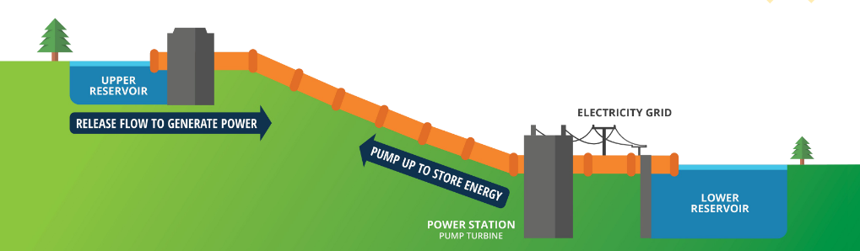
The Pumped Hydro Energy Storage Concept
FUTURE WIND POWER DEVELOPMENT
(Evolve Power, Tent Mountain Pumped Hydro Energy Storage 2023 https://evolvepower.ca/portfolio/tent-mountain-pumped-hydro-energy-storage/)

Slide 6
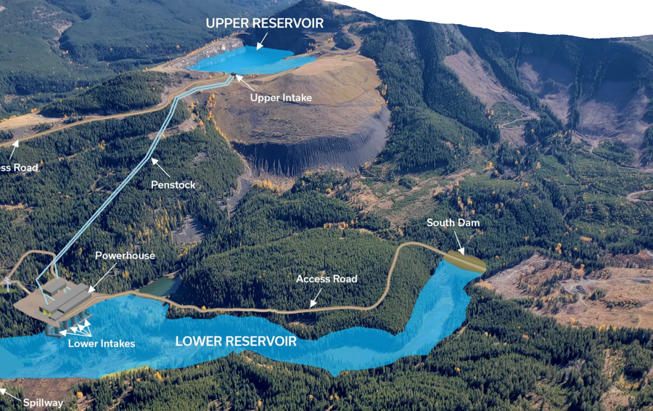
Scope of Work
Fall:
Upper Reservoir Design
Lower Reservoir Design
Winter:
Water Balance
Hydrological Modelling
Long-Term Climate Change Modelling
Operations Plan
Mitigation and Adaptation
(Evolve Power, Tent Mountain Pumped Hydro Energy Storage 2023 https://evolvepower.ca/portfolio/tent-mountain-pumped-hydro-energy-storage/)

Slide 7
Proposed Reservoir Designs
These designs are the basis for our site analysis.

Slide 8
Upper Reservoir
Water Level / Intake Level Selection
Lowest Option
Pros:
Less grouting required
Minimizes Dead Storage
Least Expensive
Cons:
Difficult Intake constructability
Option | Intake Level (MASL*) | Water Level (MASL*)
Lowest | 1760 | 1803
Medium | 1770 | 1807
Highest | 1777 | 1810
*Meters Above Sea Level

Slide 9
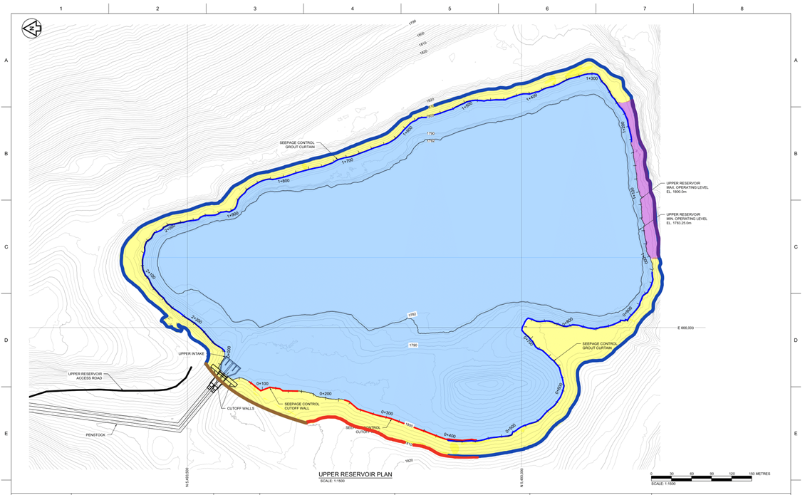
Upper Reservoir
Water Level & Intake Level Explanation
Legend
Blue Shade: Maximum Operating Water level.
Blue Line: Surface Grout Required.
Red Line: Vertical Seepage Cutoff Wall Required.
Purple Shade: No Seepage Reduction Required.
Hatch, "Montem Resources Tent Mountain PSP Prefeasibility: Hydrological Assessment," TransAlta, 2022. [Online].

Slide 10
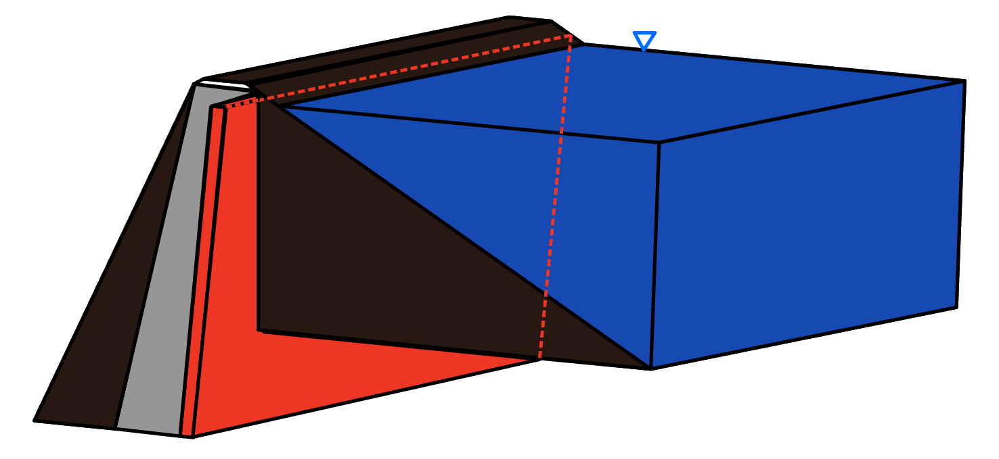
Upper Reservoir
Grouting Requirements
Vertical cut-off wall for the waste dump pile
Slurry Walls
Sheet pile/Geomembrane Walls
Grouted Barrier Walls
Exterior grouting: Grouting methods to deal with cracks in non-waste material
Consolidation Grouting
Curtain Grouting
Permeable Rock
Retained Water
Cut-off Wall

Slide 11
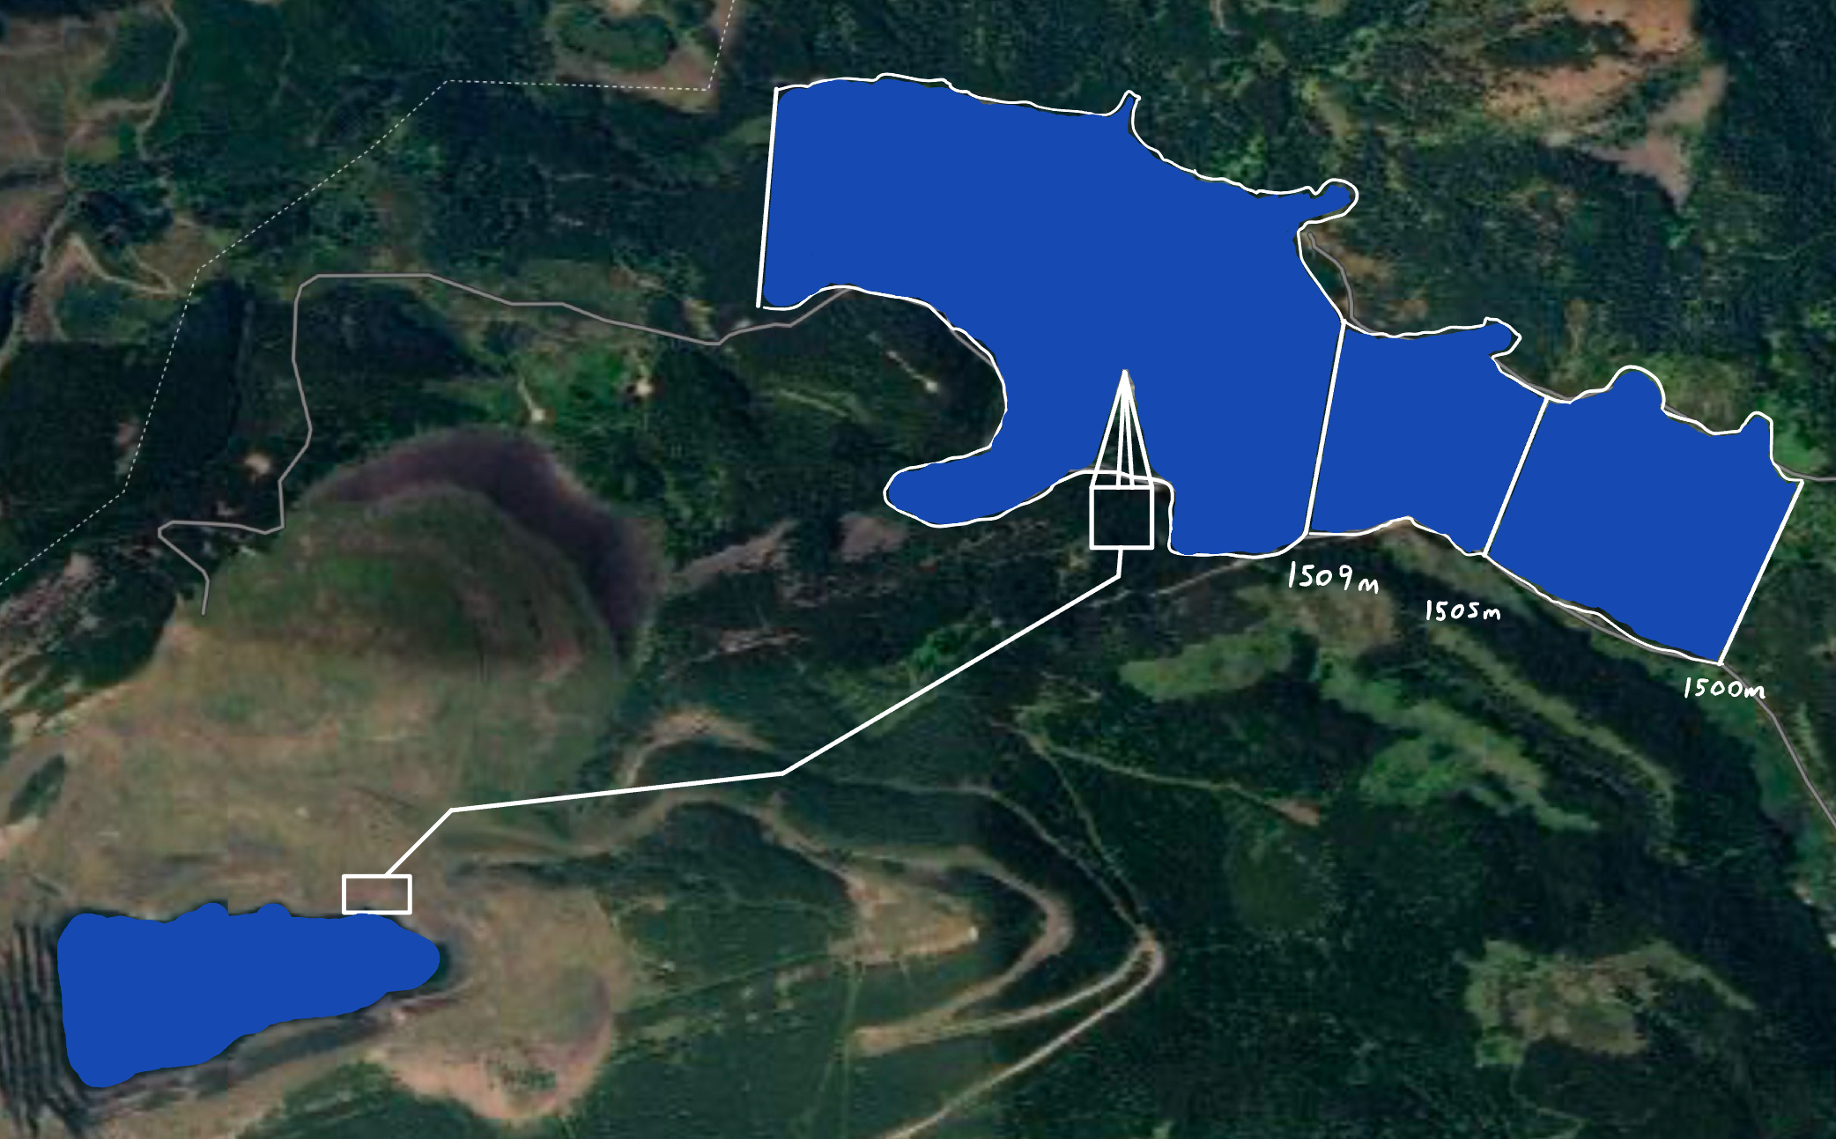
Lower Reservoir
Water Level / Dam Placement
Alternative 3 North Dam
Pros:
Least Inundated Crown Land Area
Reduced Environmental Impact
Lower Dead Storage Volume
Cons:
Smaller Catchment Area
Require larger Dams
Lower Reservoir
Alberta/BC Border
3
2
1
Upper Reservoir
North Dam Location Alternatives

Slide 12
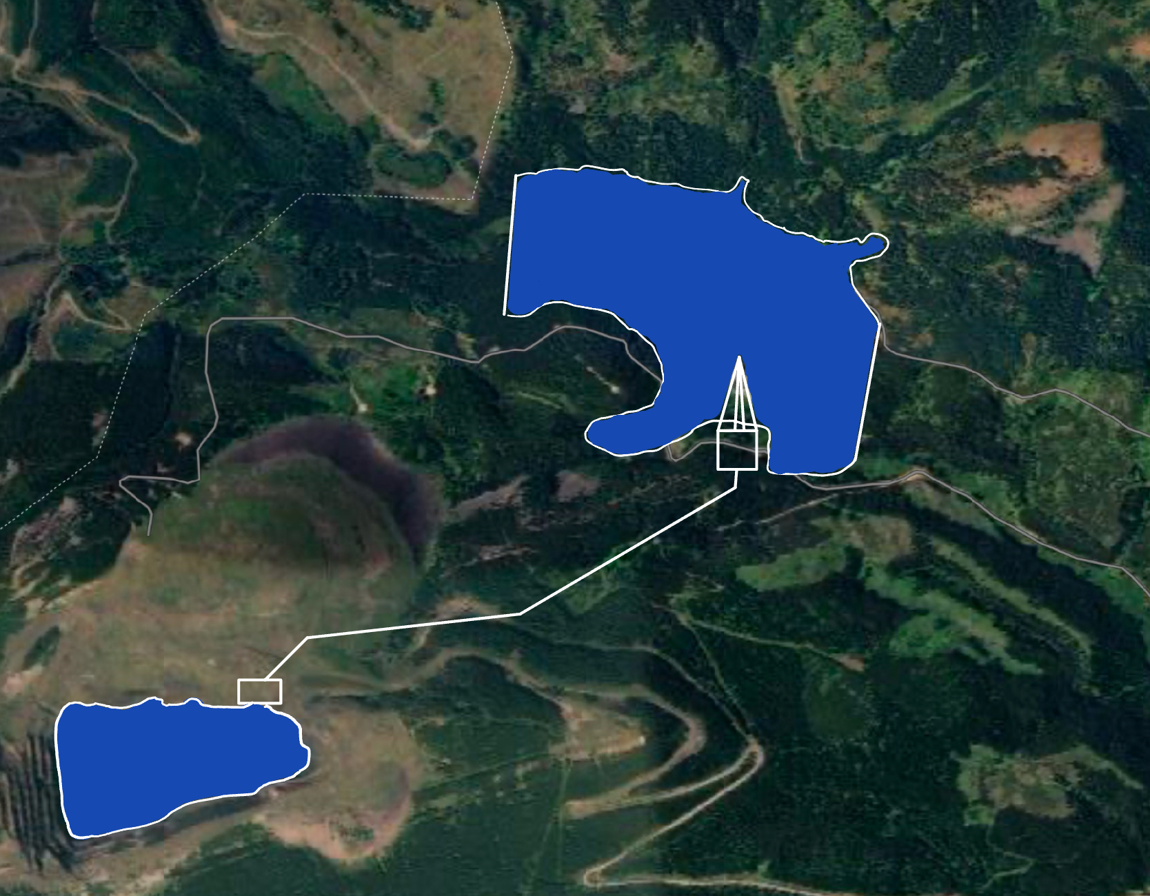
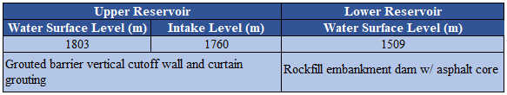
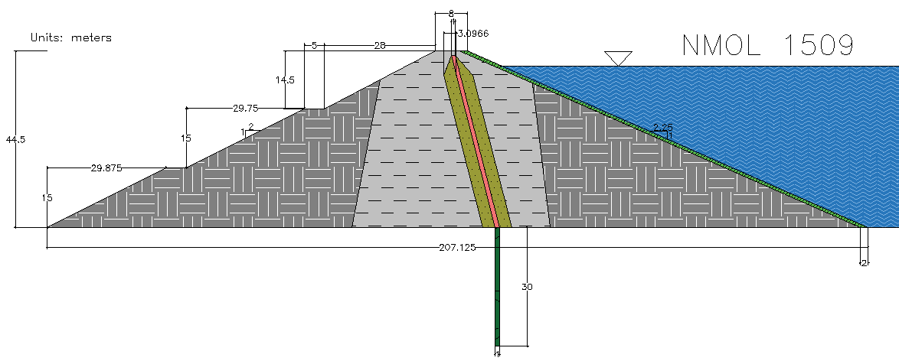
Upper & Lower Reservoir Summary
Lower Reservoir
1509m
Dam | Crest Elevation (MASL*) | CDA Classification
South Dam | 1513 | Extreme
North Dam | 1512.5 | Extreme
Intake
El. 1760m
Upper Reservoir
1803m
Dam Locations
Alberta/BC border

Slide 13
Data Sources
Challenges with meteorological and gauge data
EMDNA

Slide 14
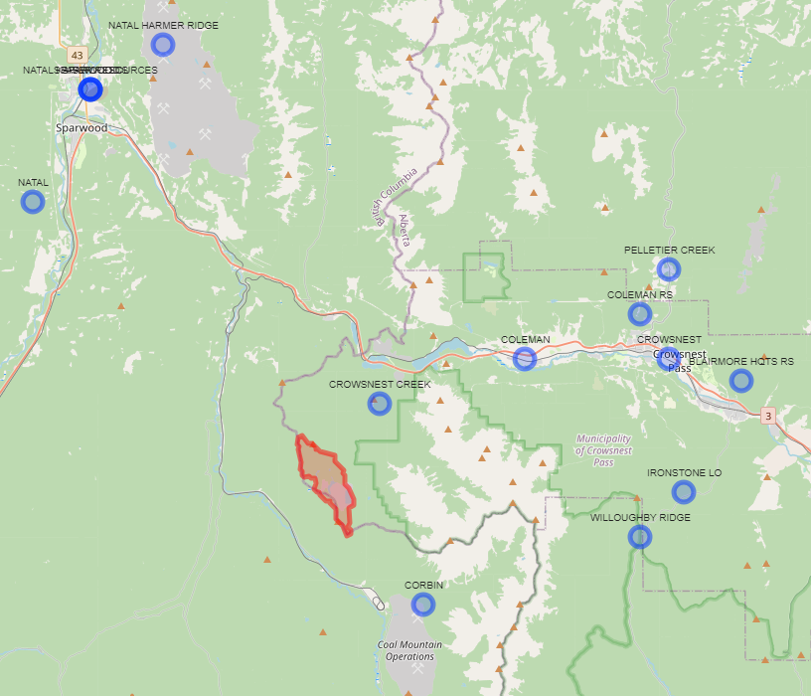
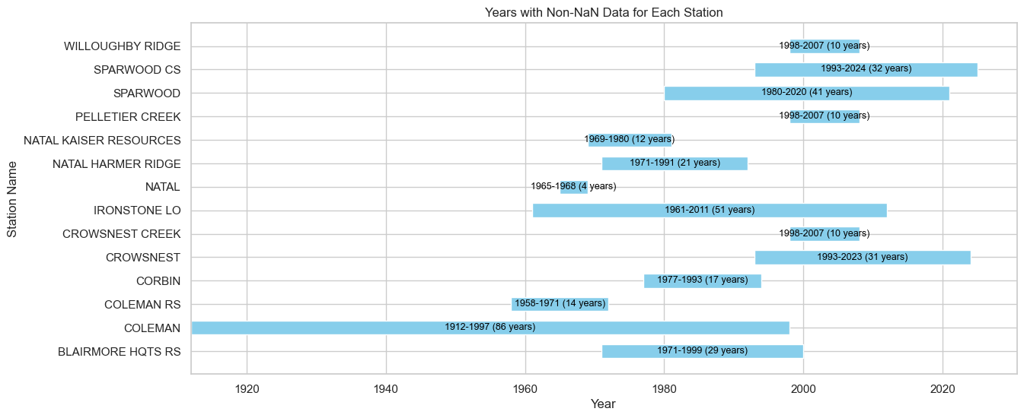
Challenges: Meteorological Data

Slide 15
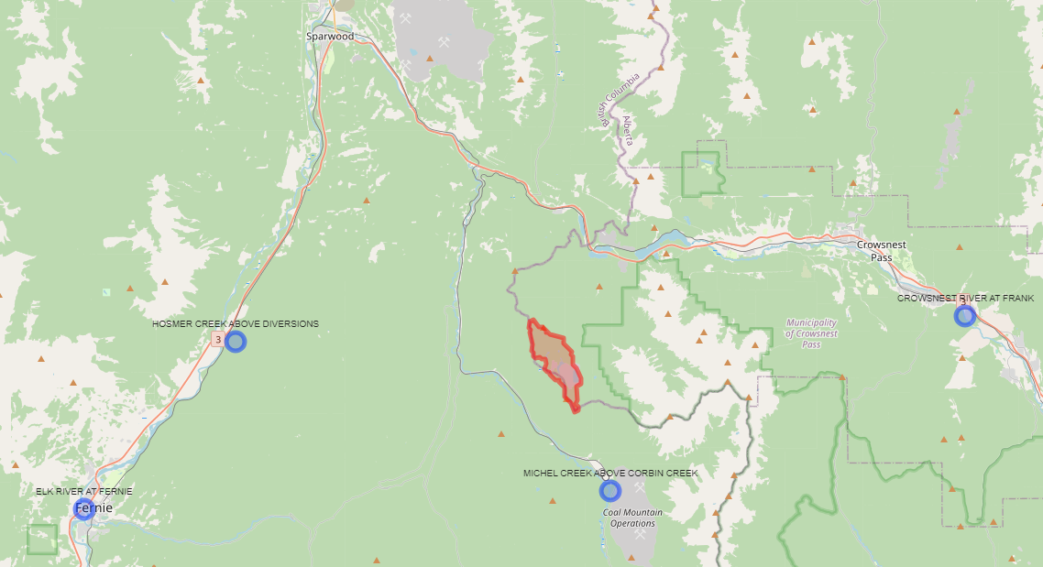
Challenges: Hydrometric Data (Gauge)

Slide 16
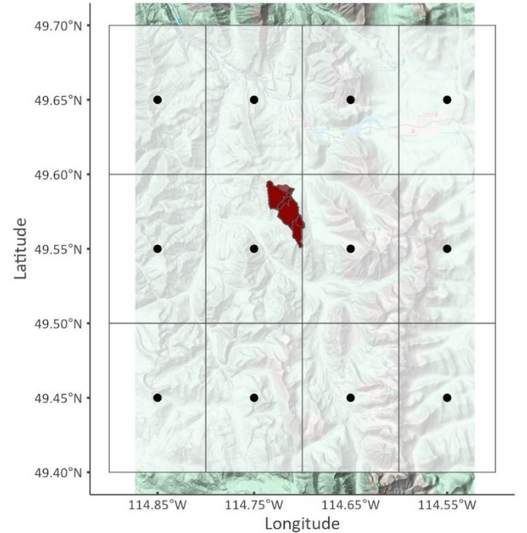
Solution: EMDNA Dataset

Slide 17
Water Balance
With specific emphasis on evapotranspiration and seepage.

Slide 18
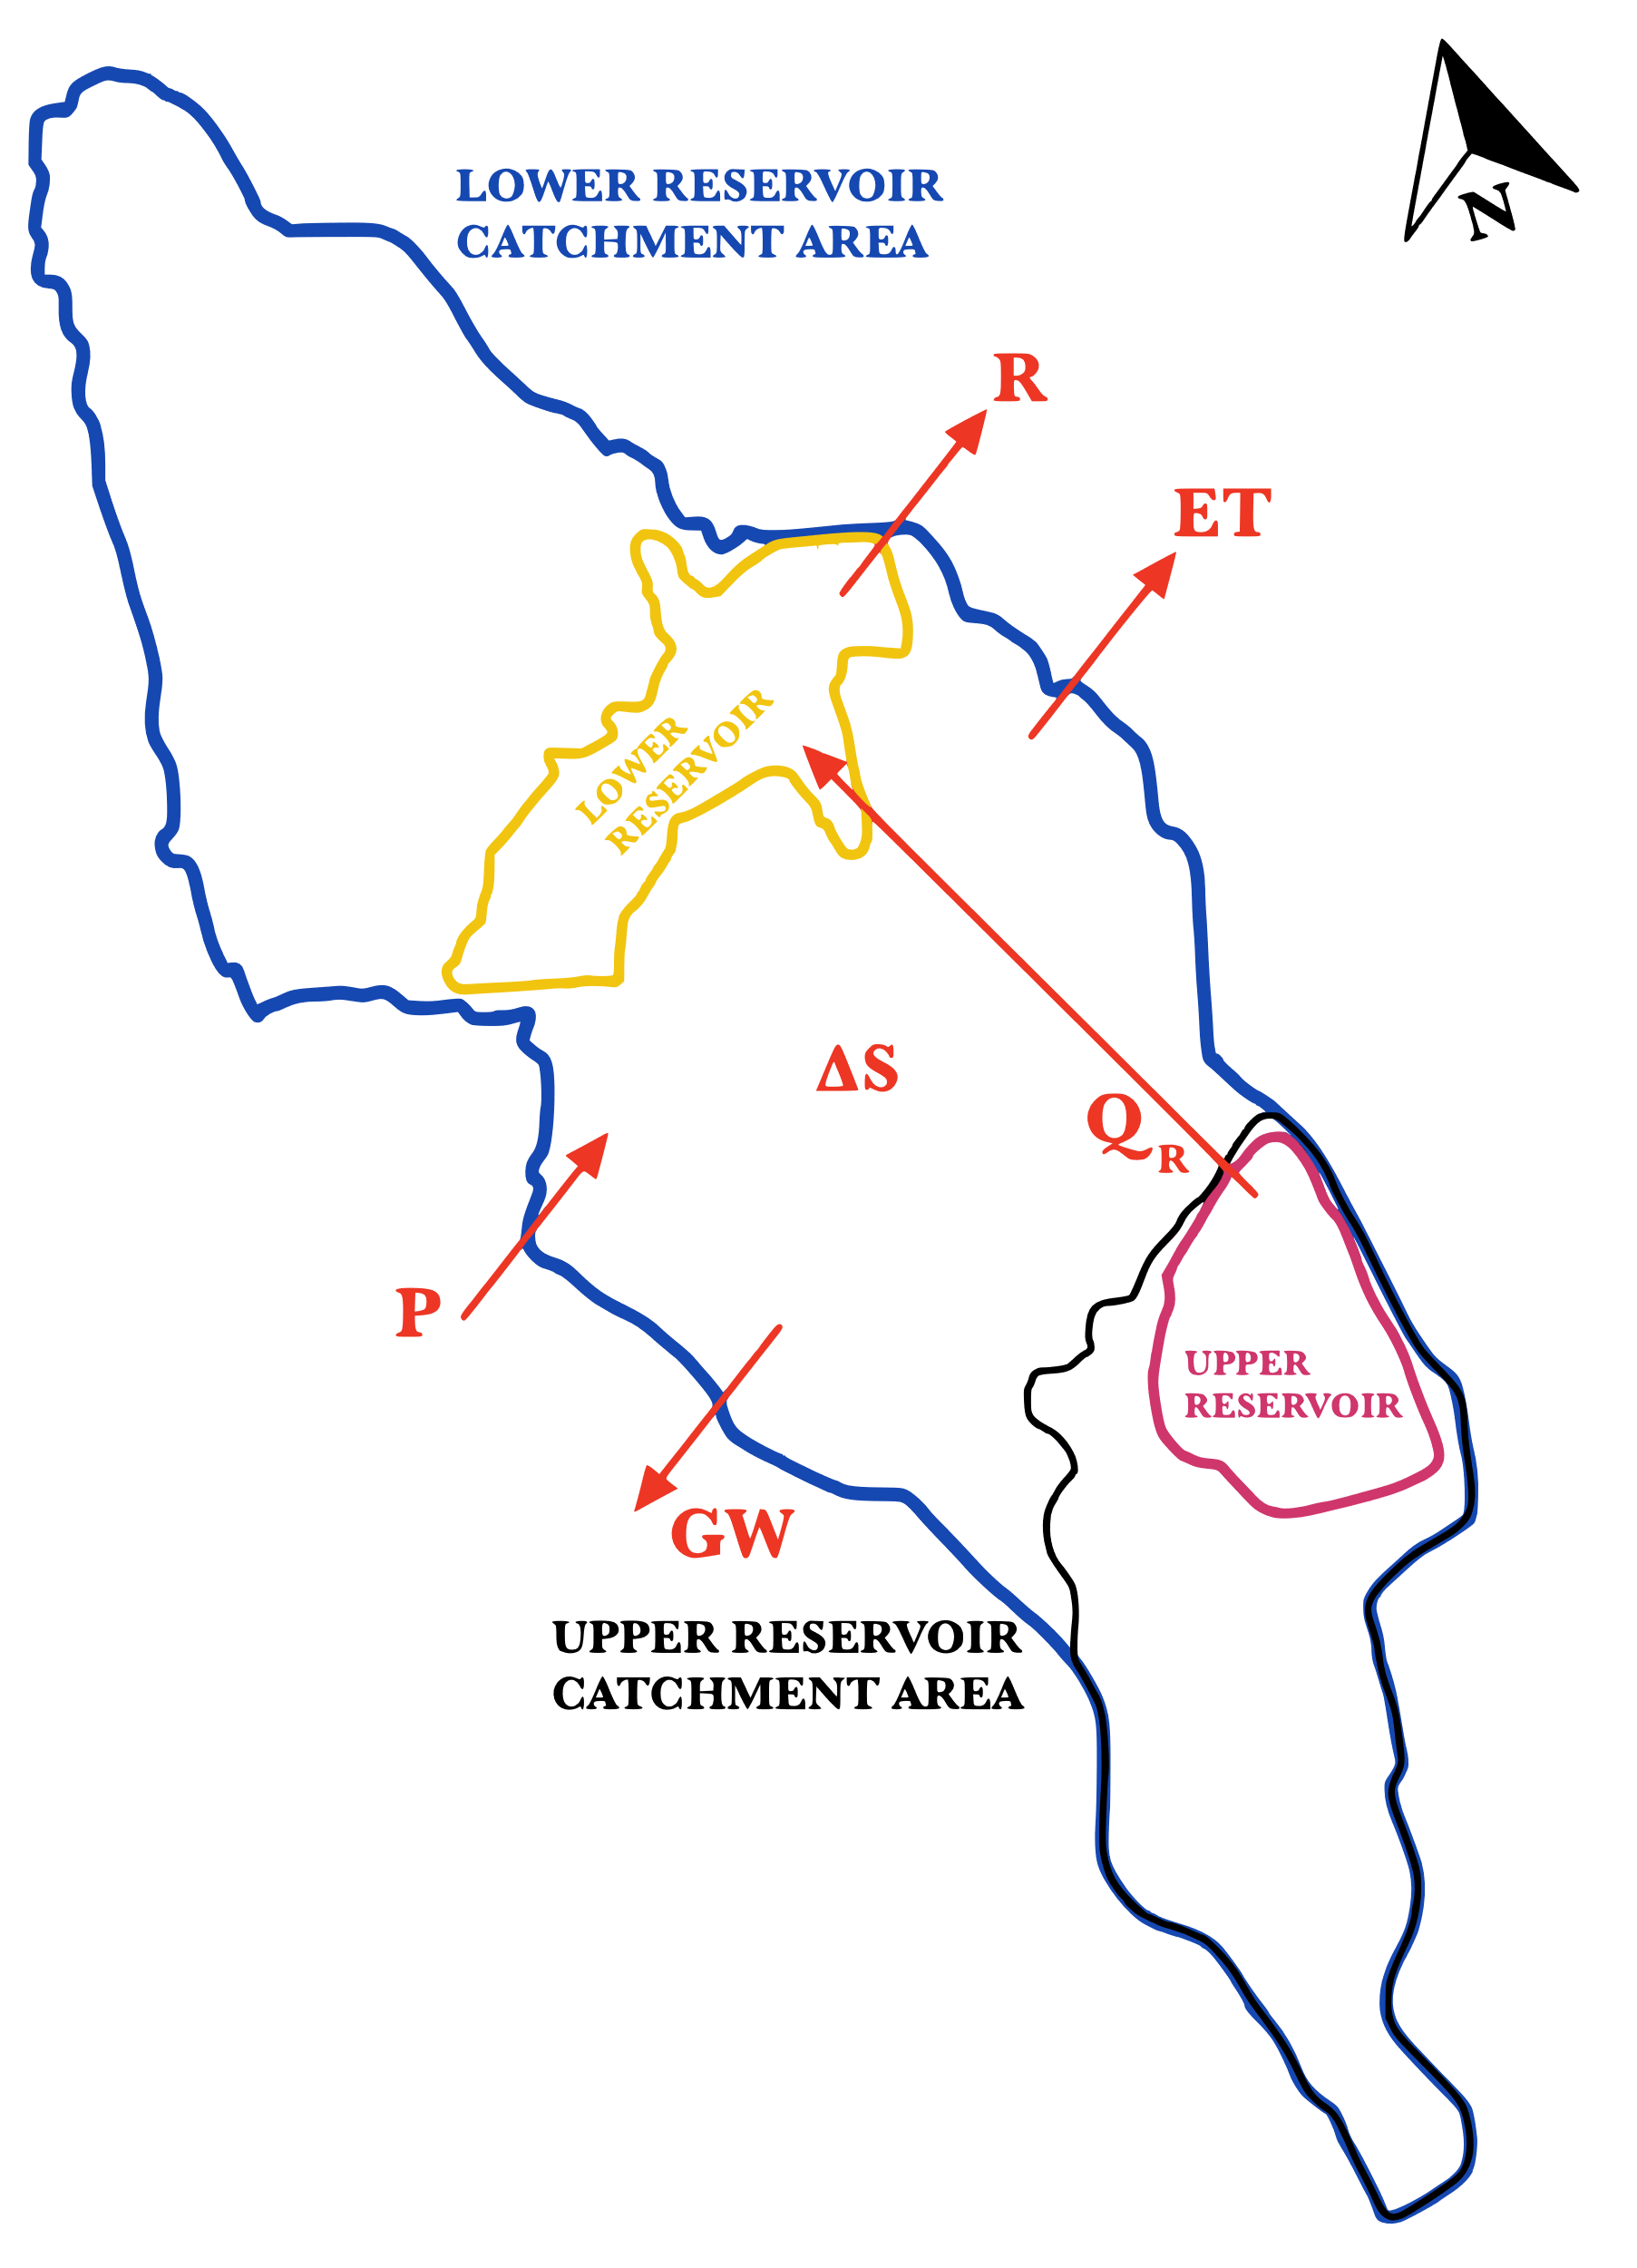
Tent Mountain Catchment Area Water Balance
Precipitation (P)
Water Balance
Groundwater Seepage (GW)
Evapo-transpiration (ET)
P-ET-∆S-GW=R
Change in Reservoir Storage (ΔS)
Runoff (R)
Q_{R} is the flow between reservoirs

Slide 19
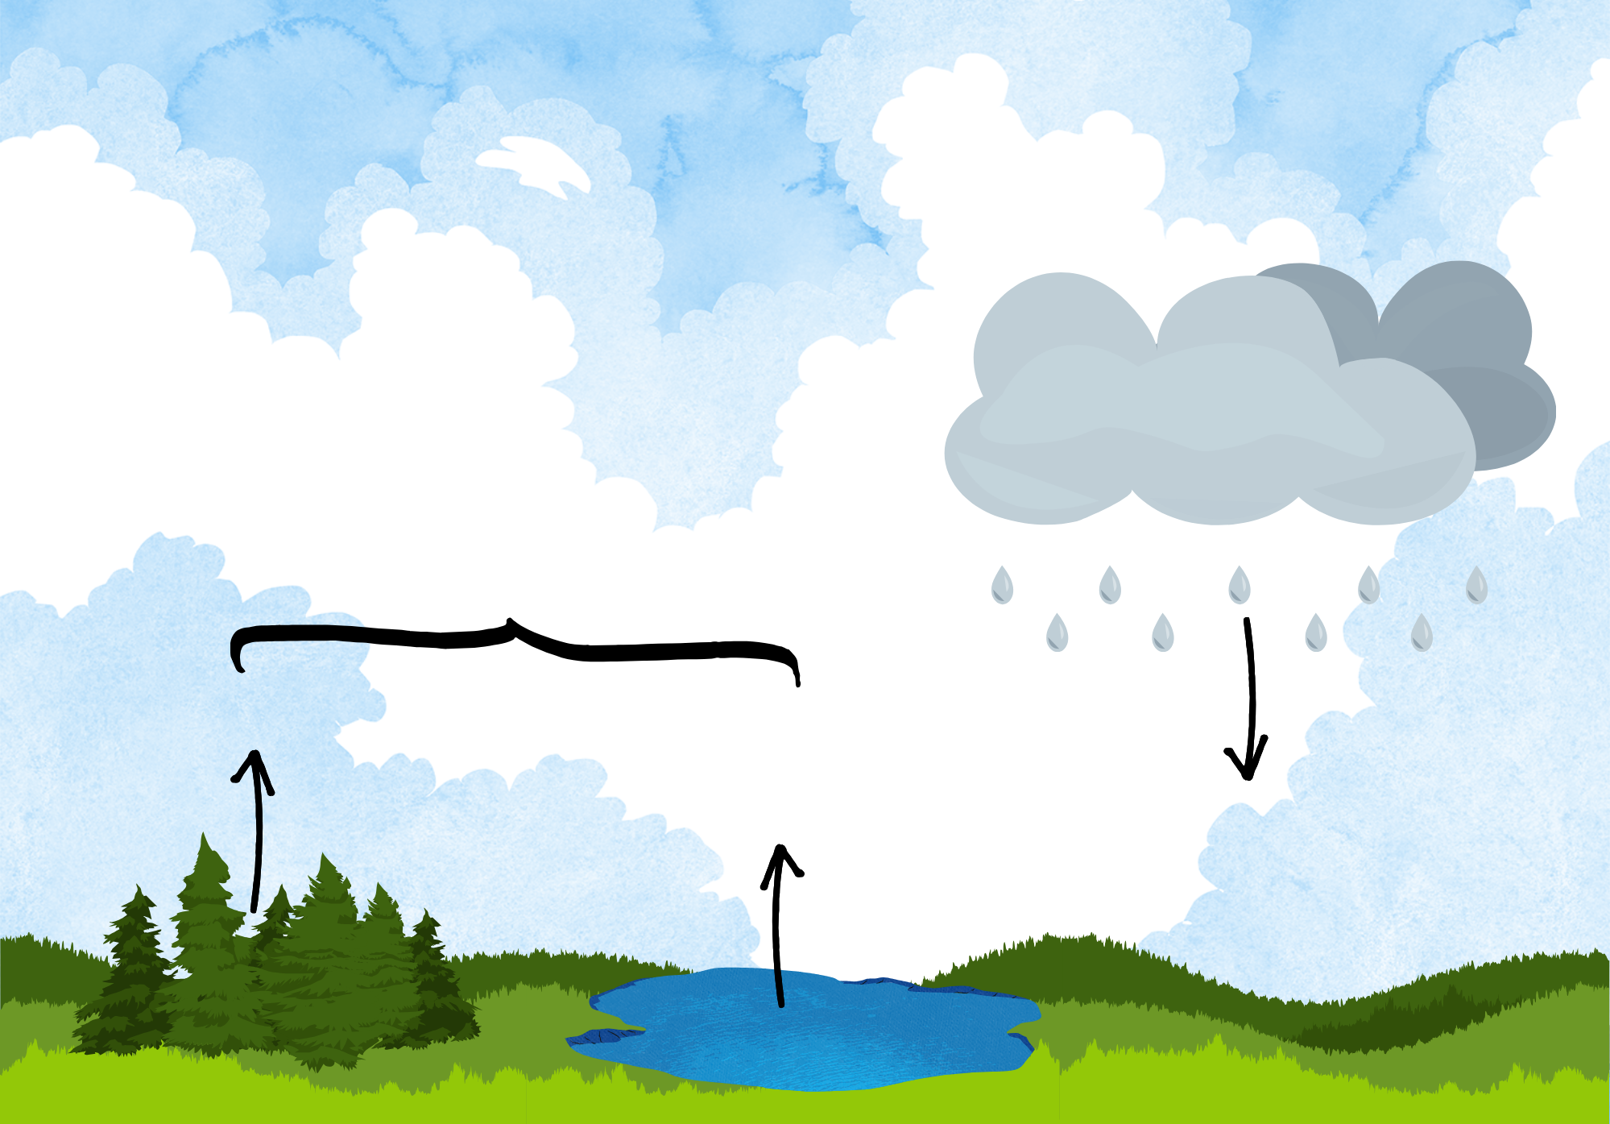
Precipitation & Evapotranspiration
Evapotranspiration
Transpiration
Evaporation
Precipitation

Slide 20


Precipitation & Evapotranspiration
Precipitation
EMDNA
Averaged over 1979-2014
Evapotranspiration
Modified Penman Equation using a weighted albedo for the basin
2014
1979
$$E_{0}=\frac{\frac{Q T_{m}}{100−A}+15\left(T−T_{d}\right)}{80−T}$$

Slide 21
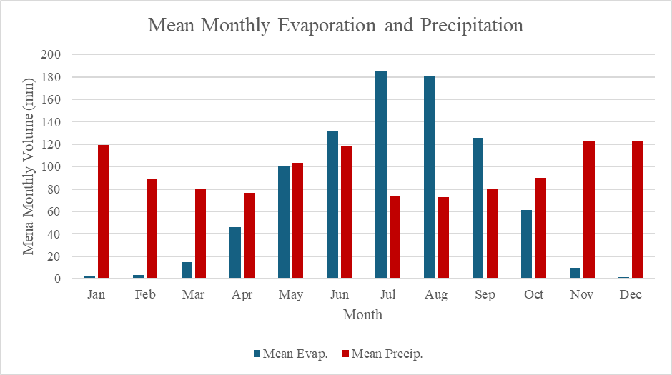
Precipitation & Evapotranspiration
Annual Mean Precipitation = 1,149 mm
Annual Mean Evapotranspiration
= 861.5 mm

Slide 22
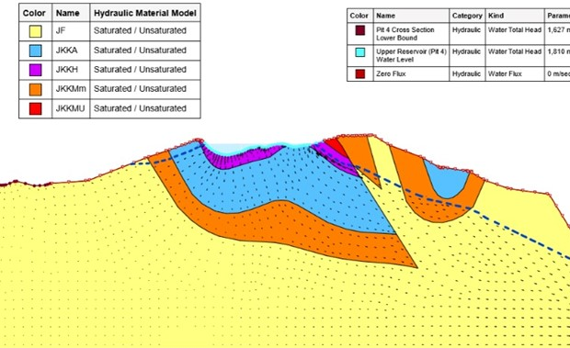
Groundwater Seepage
E-W Cross-Section

Slide 23
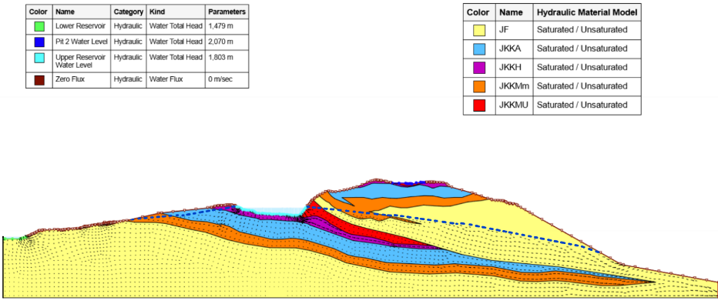
Groundwater Seepage
N-S Cross-Section

Slide 24


Groundwater Seepage
Seepage
N-S Flux (m³/s/m²) | E-W Flux (m³/s/m²) | Average Flux (m³/s/m²) | Wall Surface Area (km²) | Total Flux (m³/s)
1.63E-08 | 2.26E-10 | 8.26E-09 | 1.38E-01 | 1.14E-03
Annual Mean Groundwater Seepage = 7.95 mm

Slide 25
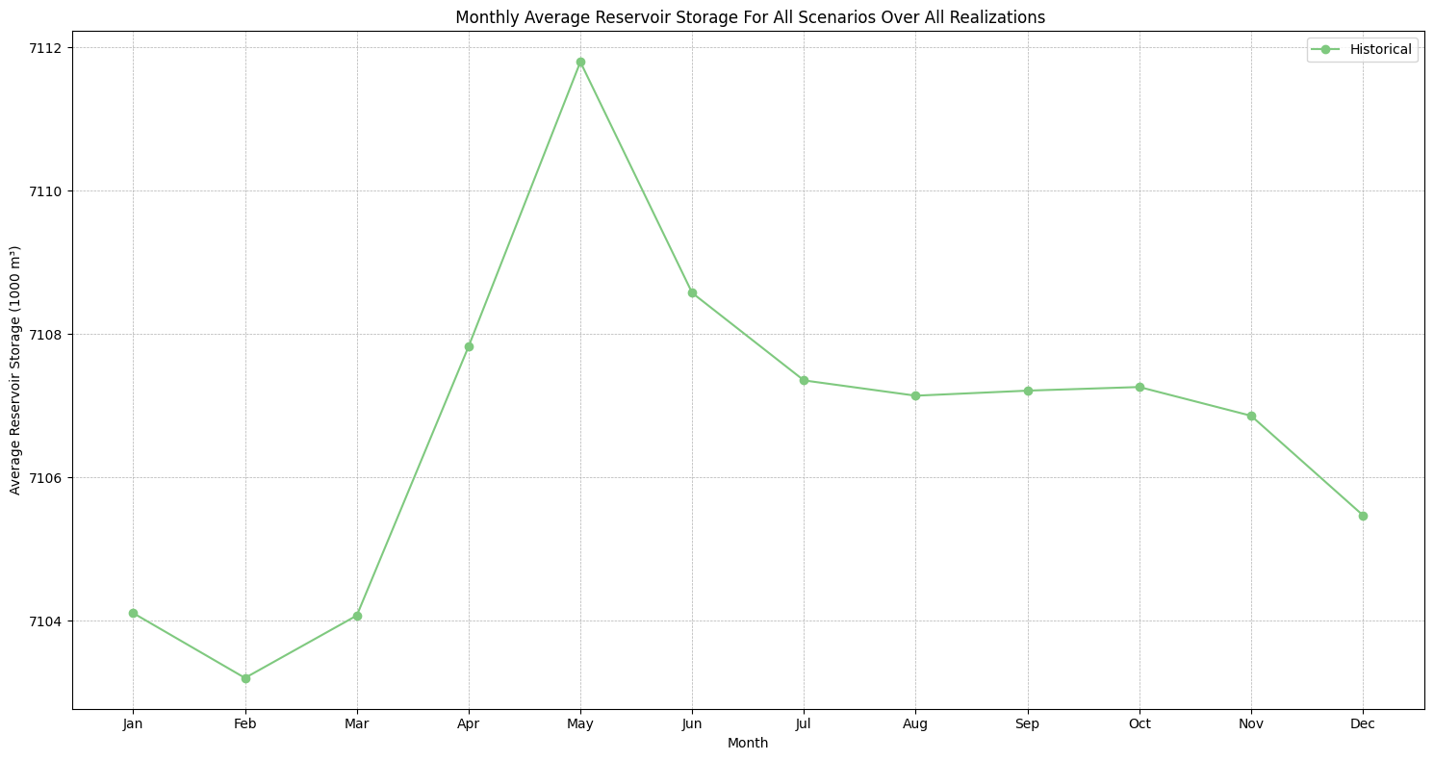
Change in Reservoir Storage
Annual Mean Change in Reservoir Storage = 1.9 mm
The graph depicts the simulated historical reservoir storage.

Slide 26
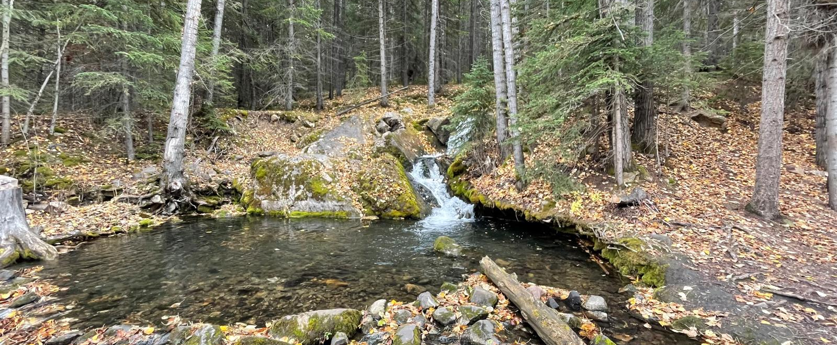
Summary
Tributary of Crowsnest Creek flowing out of Tent Mountain site
P-ET-∆S-GW=R
1149 mm – 861 mm – 1.9 mm – 7.95 mm = 278 mm/year = 0.05 cms

Slide 27
Hydrological Modelling
Hatch’s original model adapted to the purposes of (1) continuous simulation for climate modelling, and (2) event-based simulation for PMF simulation.

Slide 28


Hydrological Model Workflow
Obtain original model from Hatch.
Verify model setup and modify as necessary.
Validate modified model setup.
Analysis and operation.
HEC-HMS
Structure, parameters
Historical forcing data
Future forcing data
Continuous simulation for the Upper Reservoir.
Ensure compatibility with intended purpose.
Ensure that simulated streamflow is realistic.
Climate change impact assessment, PMF analysis.

Slide 29
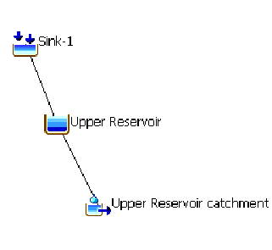
Original Model Setup
Forcing data – daily surrogate observed temperature and precipitation
Catchment area – 1.356 km²
Calibration – 2018-2020 open water season water level
Evapotranspiration – ~750 mm/year
Seepage – summer 0.006 cms, winter 0.012 cms
Snow method – temperature index
Loss method – soil moisture accounting
Transform method – SCS UH, 39 min lag time
Model Schematic

Slide 30
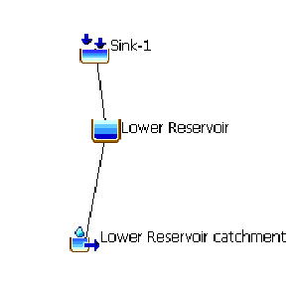
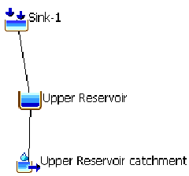
Adapted Model Setup – Continuous Simulation
Forcing data – daily EMDNA pseudo-observed temperature and precipitation
Catchment area – 1.311 km² (Upper) & 4.246 km² (Lower)
Calibration – assumed calibrated parameters valid
Evapotranspiration – modified Penman, 861 mm/year
Seepage – constant 0.0014 cms (Upper)
Snow & Loss methods – no change
Transform method – SCS UH, 39 min lag time (Upper), 60 min lag time (Lower)
Model Schematic
+
Catchments modelled separately due to HEC-HMS routing limitations

Slide 31
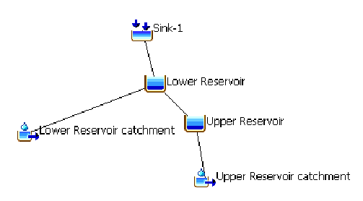
Adapted Model Setup – Event-Based Simulation
Forcing data – synthetic SCS Type II storm (24-hour PMP of 247 mm), 5 min time step
Catchment area – no change
Calibration – assumed calibrated parameters valid
Evapotranspiration – none
Seepage – none
Snow method – no change
Loss method – no change
Transform method – no change
Model Schematic
Catchments modelled together due to assumption of no pumping

Slide 32
Climate Modelling
Coupled Model Intercomparison Project Phase 6 (CMIP6)
Climate Change Projections

Slide 33
Future Climate Projections
CMIP6 Model
Future Climate Scenarios
Years 2015-2100
Scenario 1
Scenario 2
Scenario 3
Scenario 4
Positive human development
Society prioritizes economic and institutional growth
Sustainable practices
Renewable energies
Radiative forcing 2.6 Wm⁻²
Least impactful scenario
Society maintains current trends
Adoption of sustainable technology
Economic development at historical rates
Radiative forcing 4.5 Wm⁻²
Most realistic scenario
Pessimistic human development
Rapid population growth
Low education rate
Severe inequality
Prioritizing security
Radiative forcing 7.0 Wm⁻²
Second most impactful scenario
Rapid economic growth
Institutional improvement
Energy intensive projects
Increasing fossil fuel development
Radiative forcing 8.5 Wm⁻²
Most impactful scenario

Slide 34
Workflow
EMDNA Gridded data
Evaporation Calculation
HEC-HMS
Hydro-Model
Outflow
Historical
CMIP6 Model
Future Climate Scenarios
Future
Evaporation Calculation
Scenario 1
Scenario 2
Scenario 3
Scenario 4
HEC-HMS
Hydro-Model
HEC-HMS
Hydro-Model
HEC-HMS
Hydro-Model
HEC-HMS
Hydro-Model
S1 Outflow
S2 Outflow
S3 Outflow
S4 Outflow

Slide 35
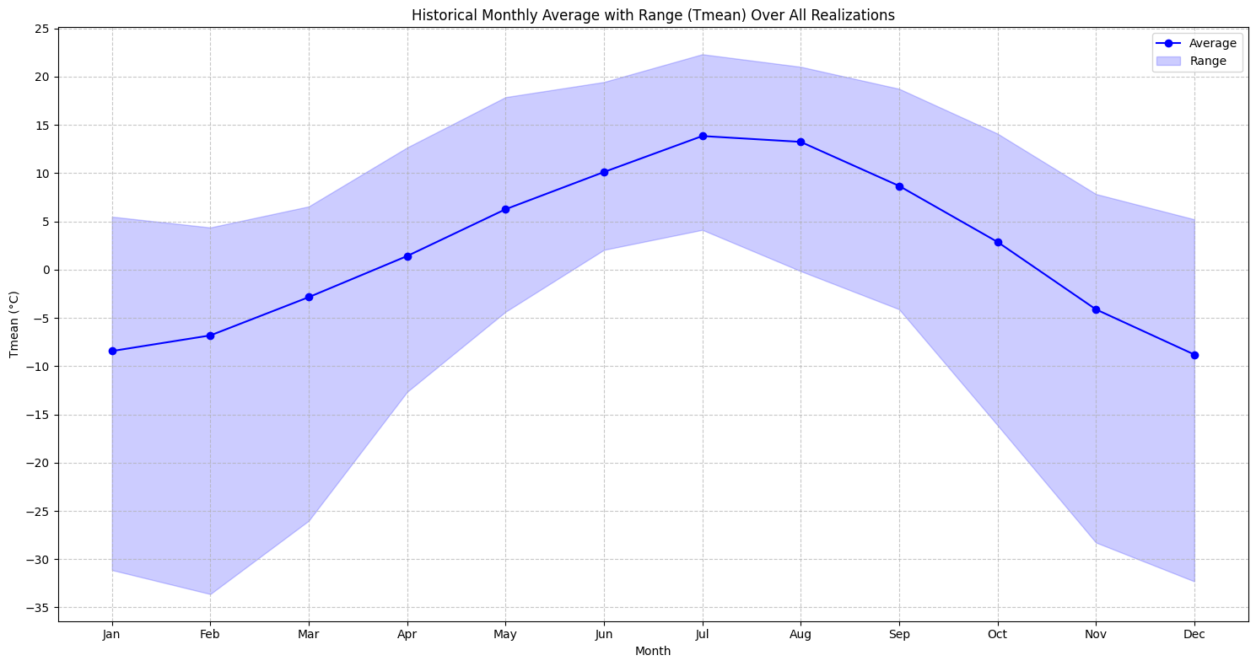
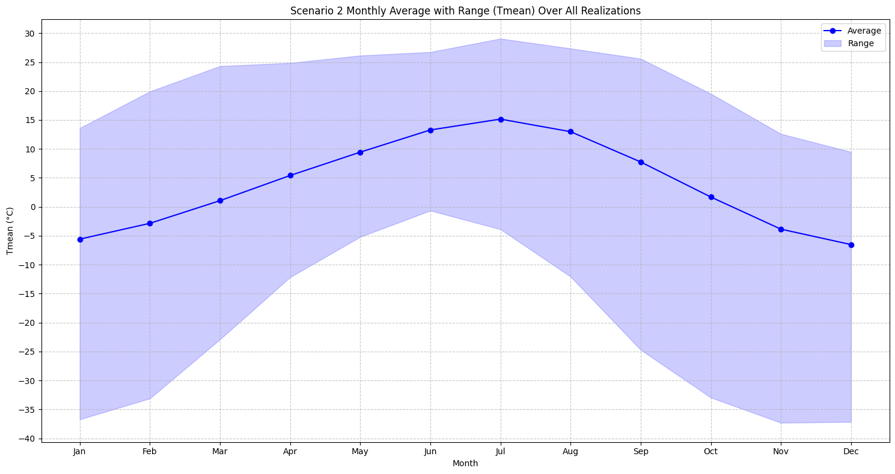
Climate Projection Results - Temperature
Historical Temperature Data
Scenario 2 Temperature Data
Average temperature ranges from -9 °C in December to 14 °C in July
Maximum temperature was 22 °C in July, minimum was -33 °C in February
Overall mean temperature appears to be around 3 °C
Average temperature ranges from -6 °C in December to 15 °C in July
Maximum temperature was 29 °C in July, minimum was -37 °C in February
Overall mean temperature appears to be around 6°C

Slide 36
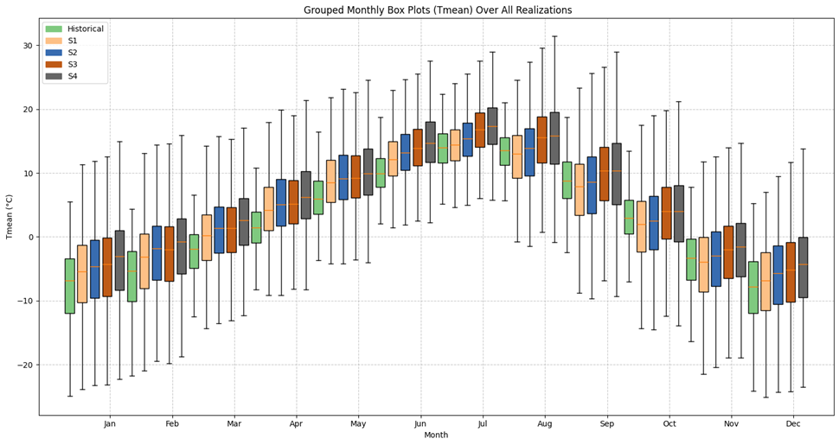
Climate Projection Results – Temperature
Temperature Scenario Comparison
Average temperature increased by approximately 2 °C from historical to Scenario 1
Each climate scenario projects an additional 1 °C temperature increase
Scenario 4 predicts an average temperature of 5 °C higher than the historical temperature for Tent Mountain
Temperature variability is larger for more extreme climate scenarios

Slide 37
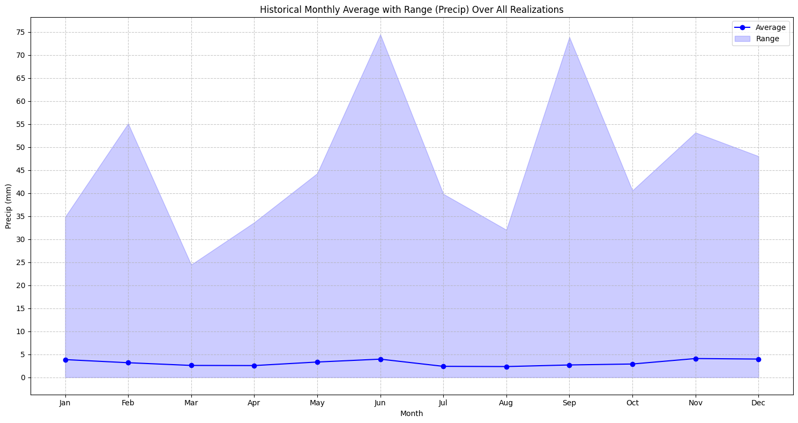
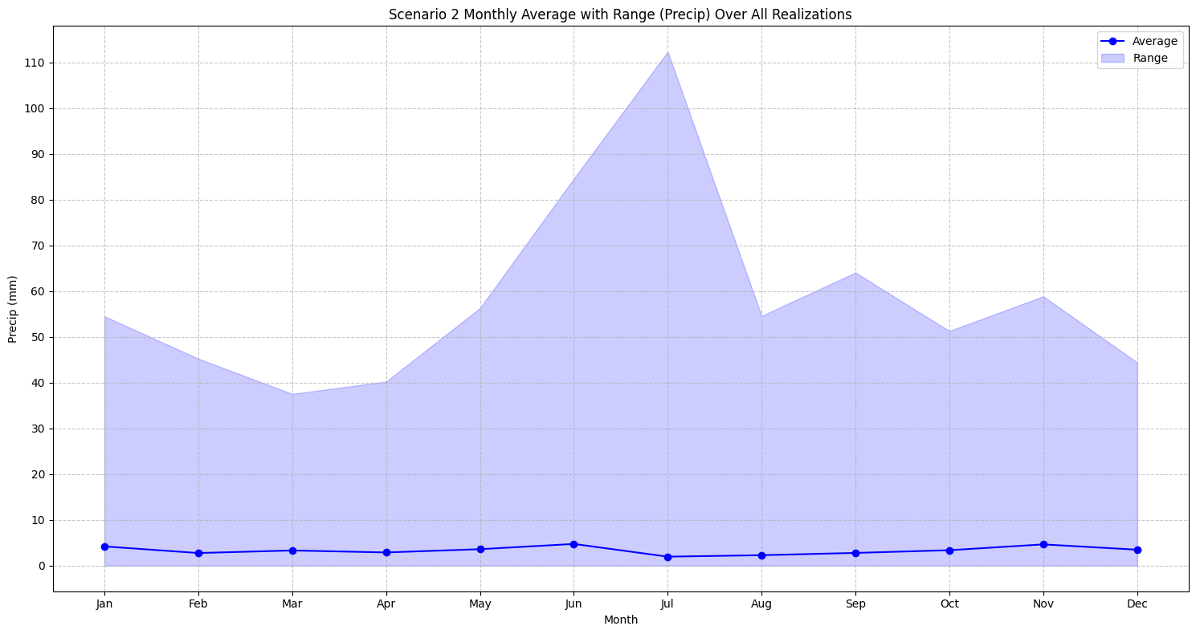
Climate Projection Results - Precipitation
Historical Precipitation Data
Scenario 2 Precipitation Data
Average precipitation per day ranges from 5 mm in June to 2.5 mm in July
The maximum daily precipitation event was 75 mm in June and September
Average projected precipitation per day ranges from 5 mm in November to 2 mm in July
The maximum projected daily precipitation event was 110 mm in July

Slide 38
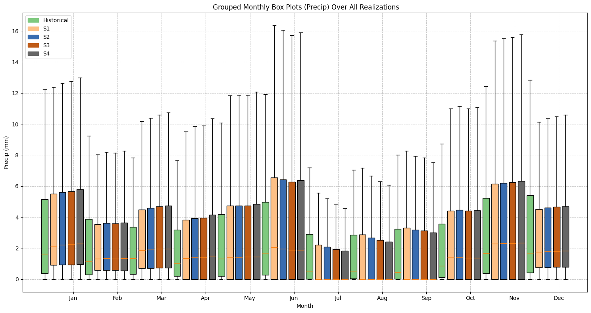
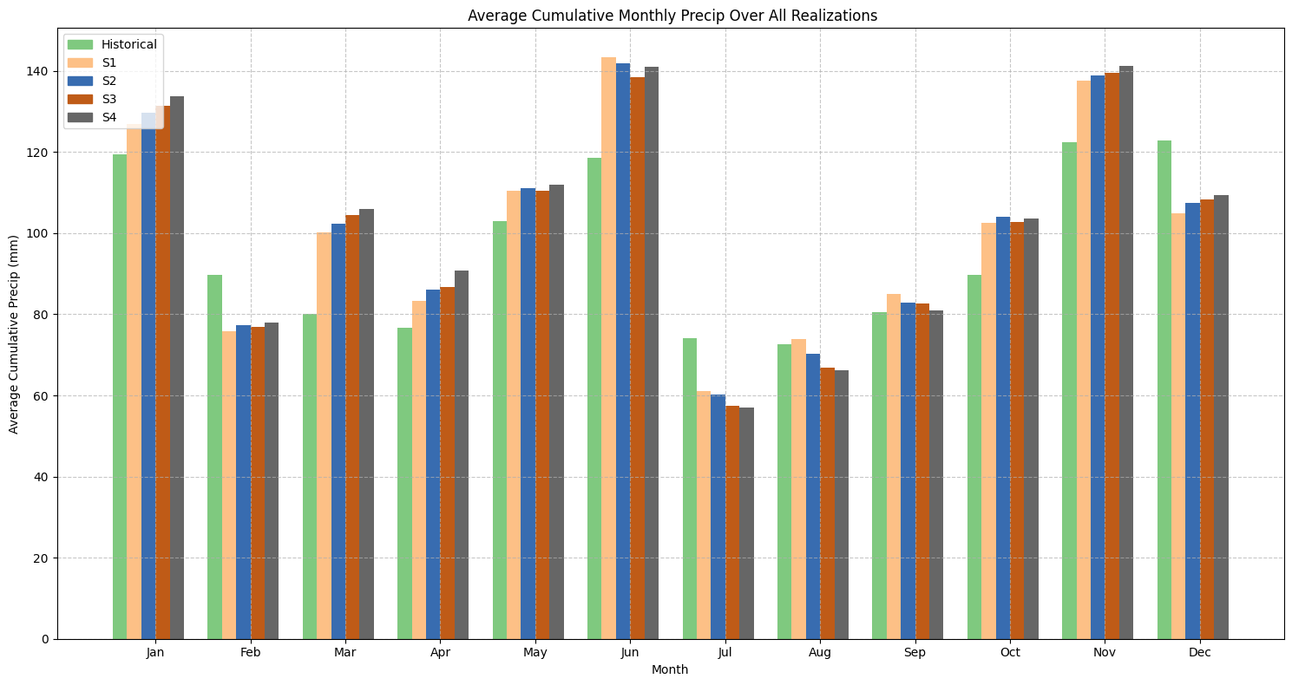
Climate Projection Results - Precipitation
Precipitation Scenario Comparison - Boxplot
Cumulative Average Monthly Precipitation
Median daily precipitation increases slightly as climate scenarios become more extreme
Summer months have median precipitations of zero in the climate projections
The highest projected cumulative monthly precipitation is around 140 mm in June, the lowest is around 60 mm in July
As climate change scenarios become more extreme more precipitation is expected at Tent Mountain

Slide 39
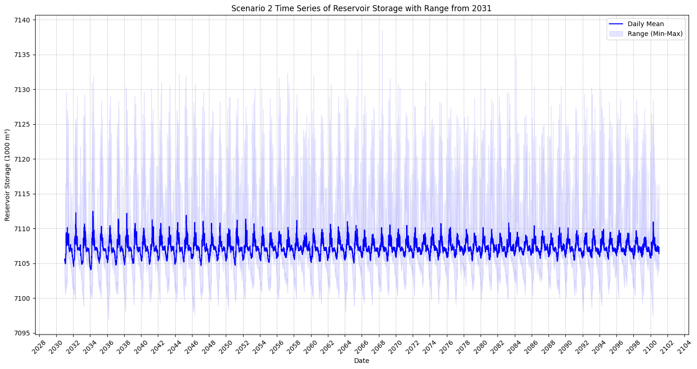
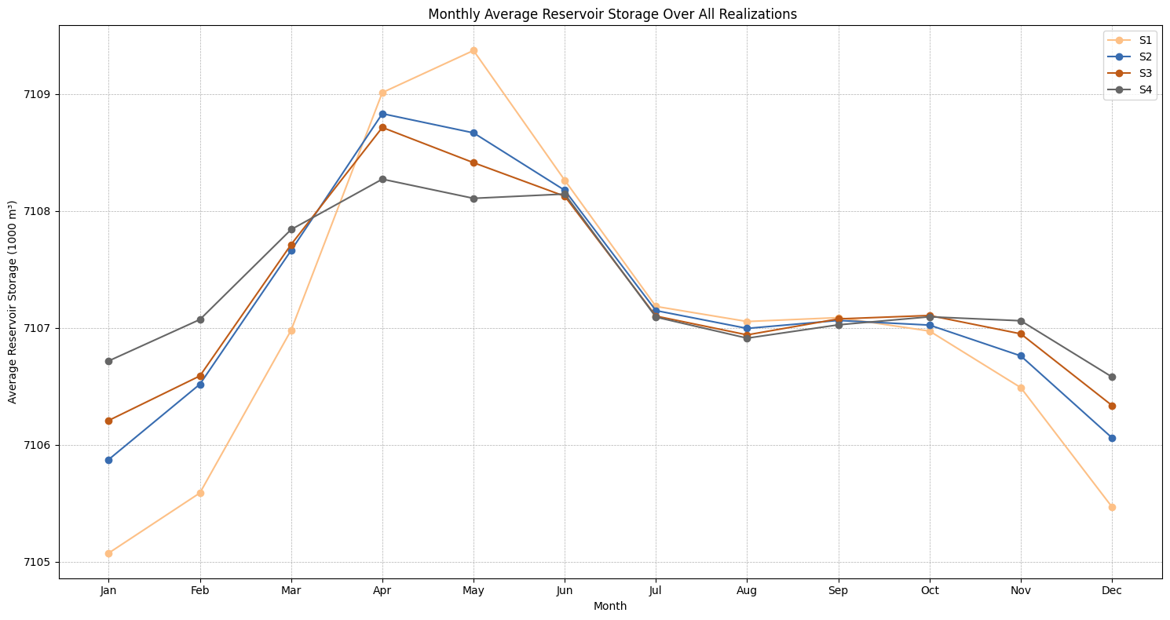
Climate Projection Results - Storage
Scenario 2 Storage Results
Average Monthly Storage Results
The HEC model had storage full for both reservoirs, so adjustments had to be made to get the mean live storage to the 16-hour operational value of 7,107,000 m³
Maximum projected storage was 7,139,000 m³, minimum was 7,097,000 m³
The more extreme climate scenarios project less fluctuation in storage for the TM-PHES
Storage values are expected to be the highest in April and May, and the lowest in December and January

Slide 40
Climate Projection Results - Storage
Storage Fluctuation Summary
Situation | Scenario | Volume (m³) | Operational Time (h) | Δ Upper Reservoir Water Level (mm)
Overall Max. | S2 | 7,139,000 | 16.07 | 116.03
Highest Max. Mean | S1 | 7,112,000 | 16.01 | 18.3
Lowest Max. Mean | S1 | 7,104,000 | 15.99 | -10.88
Overall Min. | S2 | 7,097,000 | 15.97 | -32.26

Slide 41
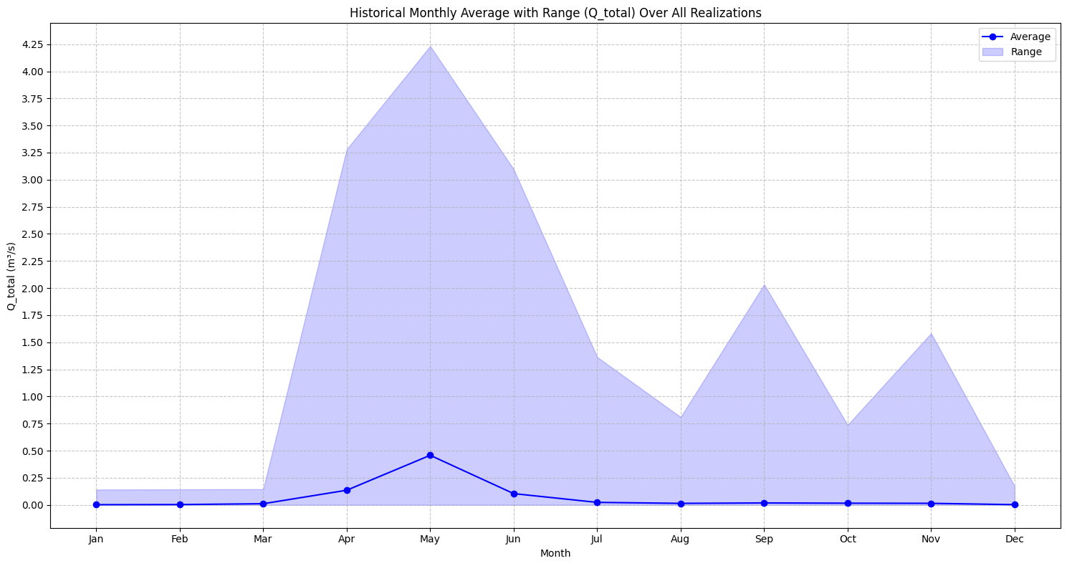
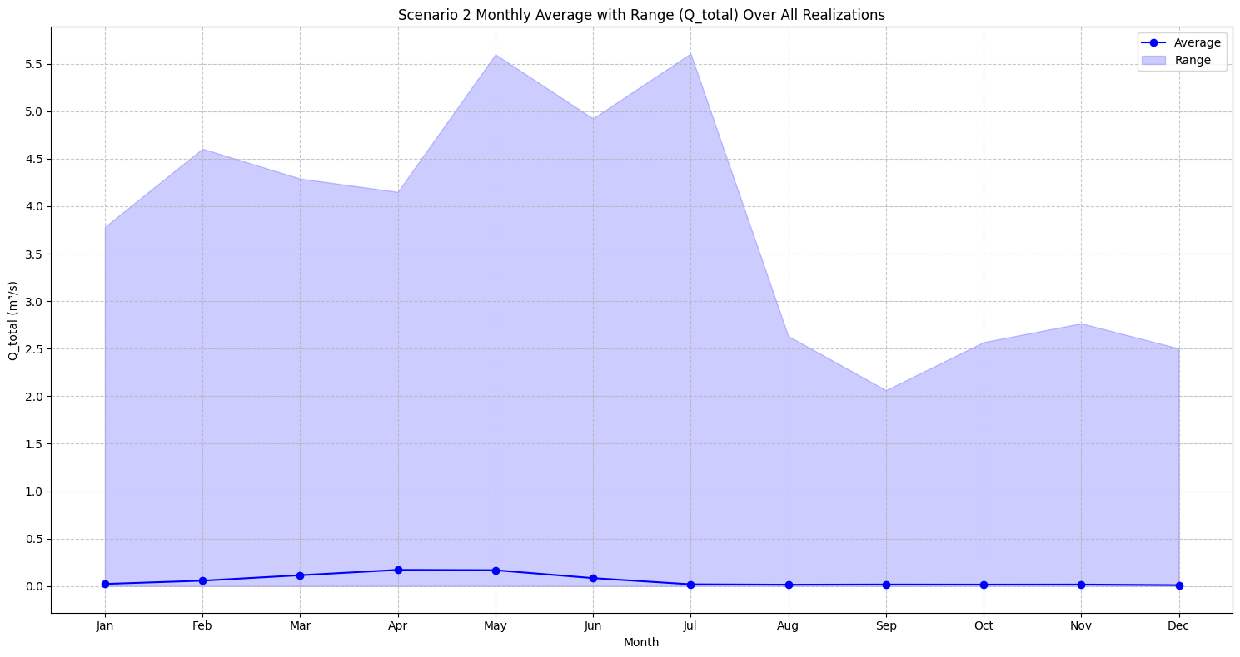
Climate Projection Results - Outflow
Historical Outflow Results
Scenario 2 Outflow Results
Average daily outflow rate ranges from 0.5 m³/s in May to near 0 m³/s from July to March
Maximum outflow was 4.25 m³/s and occurred in May
Average daily outflow rate ranges from 0.2 m³/s in April and May to near 0 m³/s from July to January
Extreme outflow events are projected to occur in May and July, with a projected maximum value of 5.5 m³/s

Slide 42
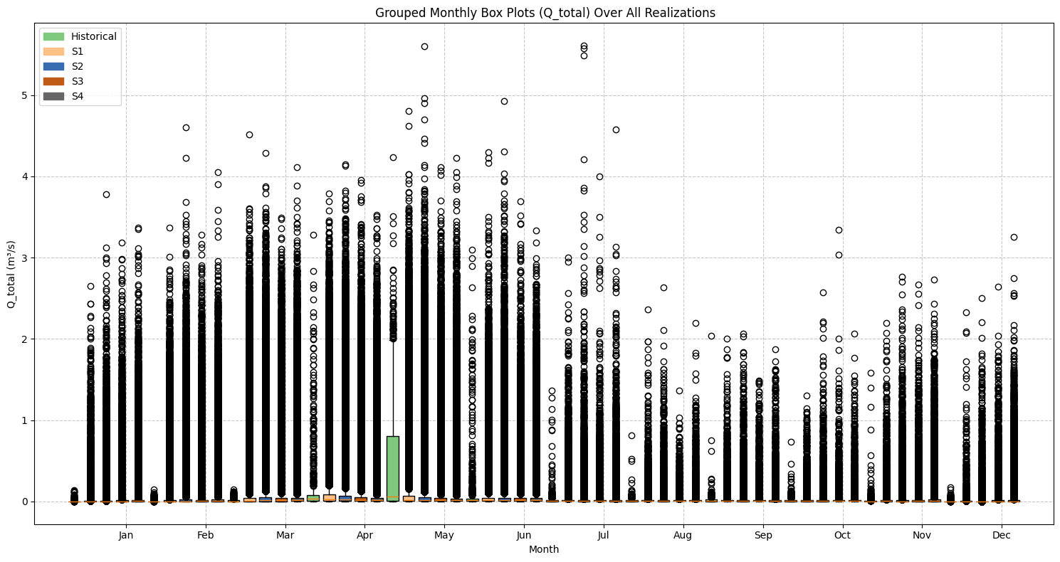
Climate Projection Results – Outflow
Outflow Scenario Outlier Comparison
The biggest outflow outliers are projected to occur in Scenario 2
May and July are projected to have the biggest outliers, while outliers over 3 m³/s are common for all climate scenarios from March to June
Historical data has a large IQR in May, likely due to snowmelt runoff in this month
The largest projected outflow (which occurred in Scenario 2) is 30% larger than the largest historical outflow event

Slide 43
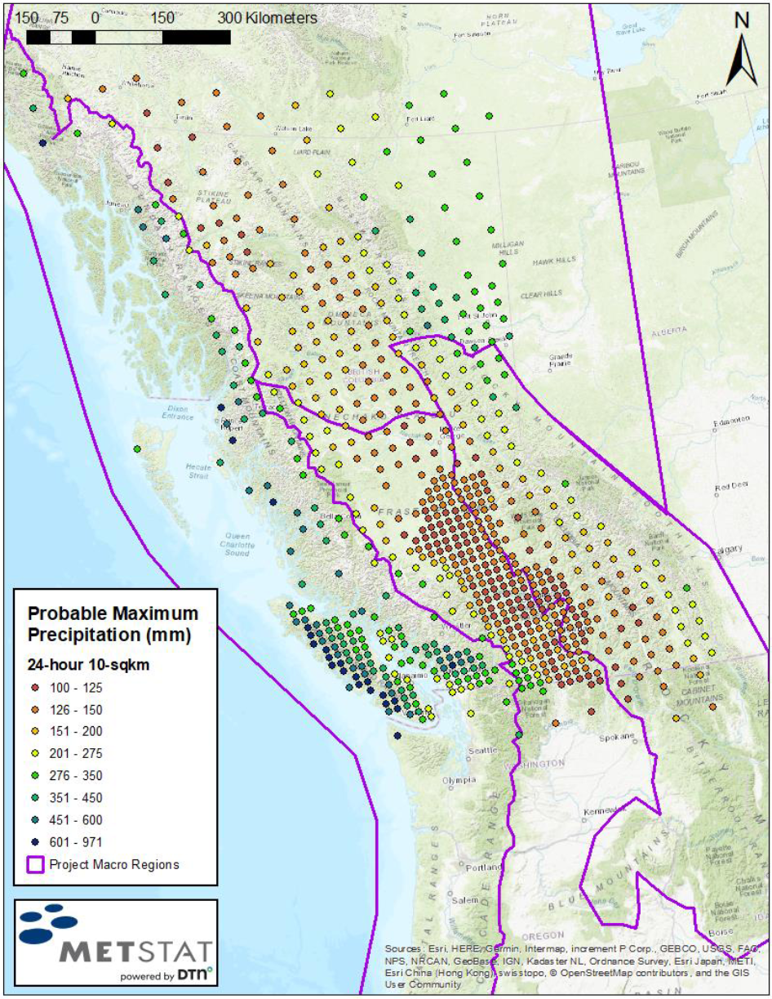
Climate Projection Results – PMP Estimate
PMP estimates from several sources for similar basins are between 200-300 mm.
PMP AEP on the eastern slopes of the Rockies estimated at 10⁻⁸.
Equivalent estimate based on:
Historical: 125 mm.
CMIP6 Scenario 2: 255 mm.
Historical record alone is insufficient for robust PMP estimation.
247 mm selected as PMP (mean of published range excluding outliers).
Tent Mountain
(approx.)
British Columbia Ministry of Environment and Climate Change Strategy, "Bulletin 2020-3-PMP, British Columbia Extreme Flood Project Probable Maximum Precipitation Guidelines – Technical Report."

Slide 44

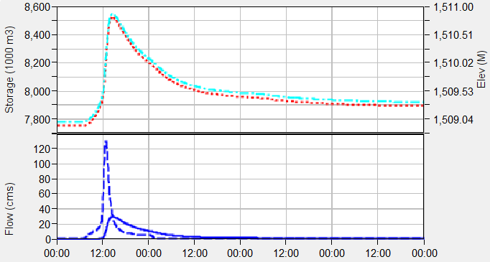
Climate Projection Results – PMF Estimate
247 mm PMP simulated using SCS type II hyetograph.
Governing scenario involves initially full Lower Reservoir.
15 m broad-crested spillway accomplishes 75% attenuation of PMF (130.4 cms inflow, 29.6 cms outflow).

Slide 45
Operations Plan

Slide 46
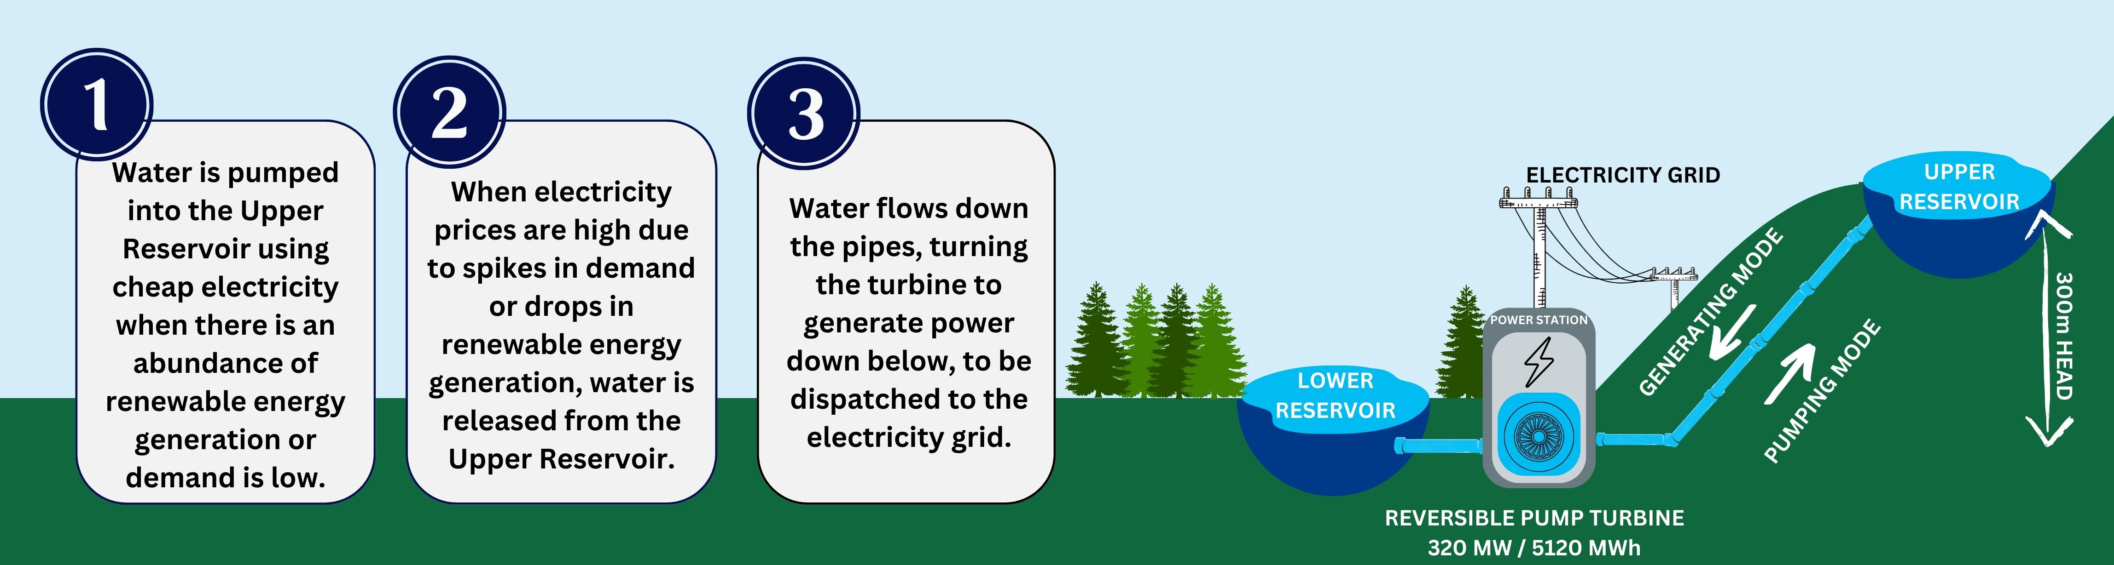
Operations Plan
Bridging the supply gaps in renewable energy generation

Slide 47
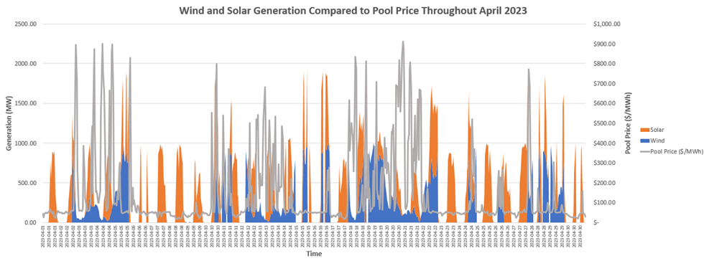
Operations Plan
Historical AESO wind and solar generation data (2023) correlated to pool price data to identify trends and optimal times to pump
Potential for use of forecasted renewable generation data to identify optimized operational schedule for generation/pumping

Slide 48
Operations Plan –Most Profitable Pool Price Hours Alberta 2022
Rank | 2022 Pool Price Hours in Alberta | Average Daily Pool Price ($/MWh)
1 | 5pm - 6pm | 292.83
2 | 6pm - 7pm | 260.88
3 | 4pm - 5pm | 256.05
4 | 7pm - 8pm | 246.58
5 | 8pm - 9pm | 220.42
6 | 3pm - 4pm | 211.85
7 | 2pm - 3pm | 190.44
8 | 1pm - 2pm | 188.39
9 | noon - 1pm | 176.48
10 | 9pm - 10pm | 170.75
11 | 11am - noon | 169.81
12 | 8am - 9am | 150.38
13 | 6am - 7am | 145.41
14 | 10am - 11am | 145.29
15 | 7am - 8am | 145.01
16 | 9am - 10am | 132.48
17 | 11pm - midnight | 131.94
18 | 10pm - 11pm | 116.37
19 | 5am - 6am | 103.98
20 | midnight - 1am | 95.21
21 | 1am - 2am | 91.24
22 | 2am - 3am | 87
23 | 4am - 5am | 85.59
24 | 3am - 4am | 84.91

Slide 49
Operations Plan – Net Revenue for different pumping operations (4:5 generating to pumping)
Options (generating - pumping) | Net Revenue ($) | Annual percent difference between generating and pumping pool prices (%)
Max Option 1 (10.66-13.33) | 102,427,340.48 | 19.15
Set Option 1 (10.66-13.33) | 61,563,407.47 | 10.24
Max Option 2 (8-10) | 154,697,133.12 | 29.28
Set Option 2 (8-10) | 69,986,023.06 | 12.03
Max Option 3 (6-7.5) | 140,851,346.39 | 27.09
Set Option3 (6-7.5) | 73,131,677,06 | 12.79

Slide 50
Operations Plan – Monthly % Differences Between Pumping and Generating Pool Prices
Max Option 1 |  | Set Option 1 |  | Max Option 2 |  | Set Option 2 |  | Max Option 3 |  | Set Option 3
Month | % Difference | Month | % Difference | Month | % Difference | Month | % Difference | Month | % Difference | Month | % Difference
AUG | 37.67 | AUG | 44.57 | AUG | 52.06 | AUG | 39.16 | AUG | 44.62 | AUG | 31.06
DEC | 30.77 | SEP | 28.17 | SEP | 45.31 | JUL | 26.28 | SEP | 40.78 | SEP | 23.02
NOV | 26.97 | JUL | 27.39 | JUL | 33.84 | SEP | 25.14 | OCT | 31.91 | JUL | 22.85
SEP | 26.63 | JUN | 12.04 | OCT | 33.80 | JUN | 12.93 | JUL | 31.12 | FEB | 13.93
FEB | 25.31 | FEB | 9.69 | DEC | 31.08 | FEB | 12.38 | NOV | 29.18 | JUN | 11.68
JAN | 20.96 | DEC | 6.08 | NOV | 30.91 | DEC | 8.41 | DEC | 28.27 | JAN | 9.39
JUL | 17.54 | JAN | 5.70 | JUN | 26.78 | JAN | 7.17 | JUN | 25.01 | NOV | 9.33
JUN | 14.59 | NOV | 4.73 | FEB | 26.19 | NOV | 6.26 | FEB | 24.81 | DEC | 9.28
OCT | 11.94 | MAY | 2.00 | JAN | 22.26 | MAY | 3.11 | JAN | 21.55 | OCT | 8.42
MAY | 7.43 | OCT | 1.13 | MAY | 19.86 | OCT | 2.50 | MAY | 19.15 | MAY | 4.39
MAR | 6.10 | MAR | -7.40 | APR | 16.67 | MAR | -4.05 | APR | 16.26 | MAR | -1.06
APR | 4.40 | APR | -11.56 | MAR | 12.40 | APR | -8.59 | MAR | 12.23 | APR | -4.17

Slide 51
Open Floor Q/A

Slide 52
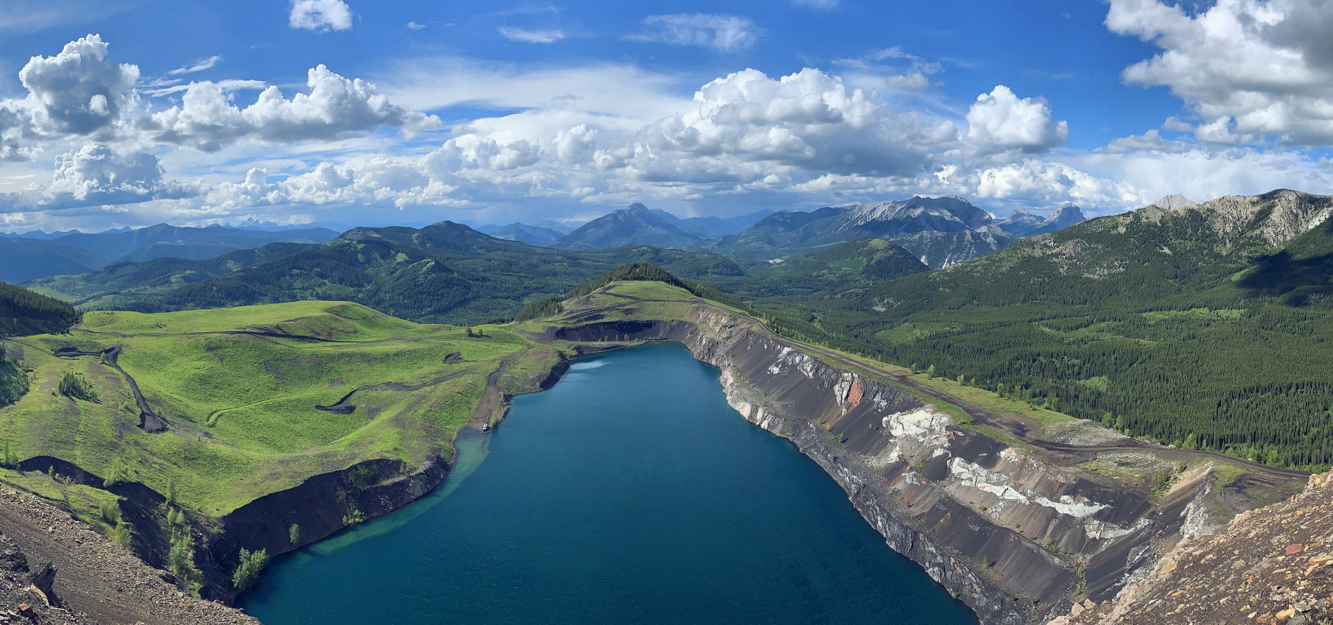


Thank you For Listening! Please Visit our Website
NOTE TO USER: THIS IS A PRE-BUILT SLIDE
Duplicate and update the information on this slide as needed and delete all yellow notes before using in final presentation.
OR: delete this slide if not being used in final presentation
Visit the TransAlta official image library to access more photographic imagery to use in presentations

